Slide 1
Automated Testing
Page Object Model

Slide 2
Page Object Model
Page Object Model is a design pattern to create Object Repository for web UI elements in Selenium WebDriver
Under this model, for each web page in the application, there should be corresponding page class.
This Page class will find the WebElements of that web page and also contains Page methods which perform operations on those WebElements.
Name of these methods should be given as per the task they are performing,
If a loader is waiting for the payment gateway to appear, POM method name can be waitForPaymentScreenDisplay().

Slide 3
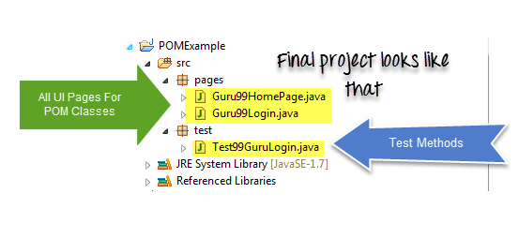
Page Object Model

Slide 4
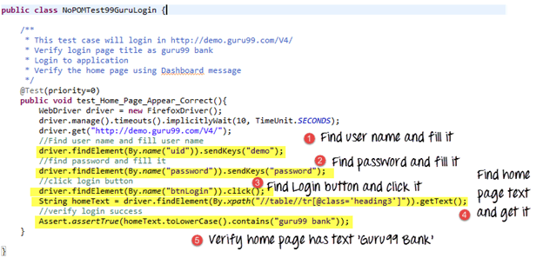
Why POM?

Slide 5
The chief problem with script maintenance is that if 10 different scripts are using the same page element, with any change in that element, you need to change all 10 scripts. This is time consuming and error prone.
Starting an UI Automation in Selenium WebDriver is NOT a tough task. You just need to find elements, perform operations on it.
In Previous code all we are doing is finding elements and filling values for those
This is a small script. Script maintenance looks easy. But with time test suite will grow. As you add more and more lines to your code, things become tough elements.

Slide 6
POM
A better approach to script maintenance is to create a separate class file which would find web elements, fill them or verify them.
This class can be reused in all the scripts using that element.
In future, if there is a change in the web element, we need to make the change in just 1 class file and not 10 different scripts.
This approach is called Page Object Model(POM). It helps make the code more readable, maintainable, and reusable.

Slide 7
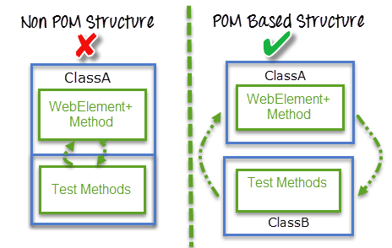
POM –Based Structure

Slide 8
Advantages of POM
We should keep our tests and element locators separately, this will keep code clean and easy to understand and maintain.
Object repository is independent of Automation Tests, so we can use the same object repository for a different purpose with different tools.
For example, we can integrate POM with TestNG/JUnit for functional Testing and at the same time with JBehave/Cucumber for acceptance testing.
Code becomes less and optimized because of the reusable page methods in the POM classes.
Methods get more realistic names which can be easily mapped with the operation happening in UI.
If after clicking on the button we land on the home page, the method name will be like 'gotoHomePage()'.

Slide 9
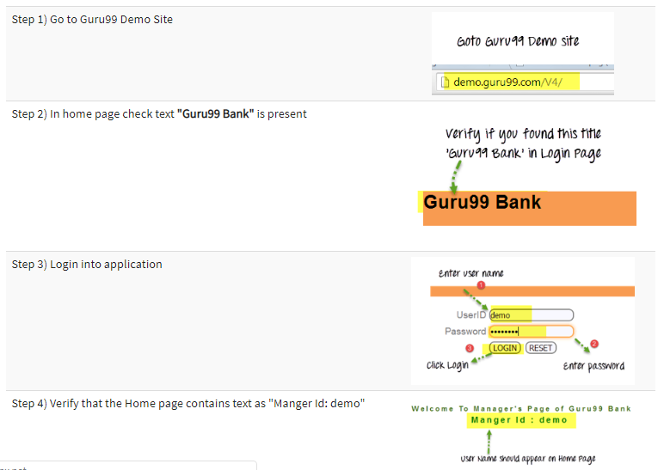

Slide 10
Data Driven Testing
Data Provider
Parameterization

Slide 11
Parameterization
We always wish our software should work differently with a different set of data.
When it comes to Testing the same piece of software, we can't be unfair to test it with just one set of data.
Here again, we need to verify that our system is taking all set of combinations which it expected to support.
Here comes Parameterization in the picture. To pass multiple data to the application at runtime, we need to parameterize our test scripts.
This concept which we achieve by parameterization is called Data Driven Testing.

Slide 12
Data Driven Testing
Data Driven Testing is a Test Design and execution strategy where the test scripts read test data from data sources (file or database) such as ADO objects, ODBC sources, CSV files, etc. rather than using hard-coded values.
This allows automation engineers to have a single test script which can execute tests for all the test data in the table.
In this framework, input values are read from data files and are stored into a variable in test scripts. Ddt (Data Driven testing) enables building both positive and negative test cases into a single test.

Slide 13
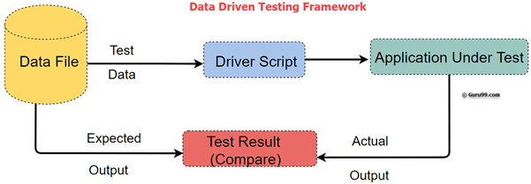
Data Driven Testing Framework
In Data-driven test automation framework, input data can be stored in single or multiple data sources like xls, XML, csv, and databases.

Slide 14
Why Data Driven Testing?
Frequently we have multiple data sets which we need to run the same tests on. To create an individual test for each data set is a lengthy and time-consuming process.
Data Driven Testing framework resolves this problem by keeping the data separate from Functional tests. The same test script can execute for different combinations of input test data and generate test results.

Slide 15
Example
In the given three scenarios first two are laborious and time-consuming. Therefore, it is ideal to follow the third approach.
This is Data Driven Framework.
For example, we want to test the login system with multiple input fields with 1000 different data sets.
To test this, you can take following different approaches:
Approach 1) Create 1000 scripts one for each dataset and runs each test separately one by one.
Approach 2) Manually change the value in the test script and run it several times.
Approach 3) Import the data from the excel sheet. Fetch test data from excel rows one by one and execute the script.

Slide 16
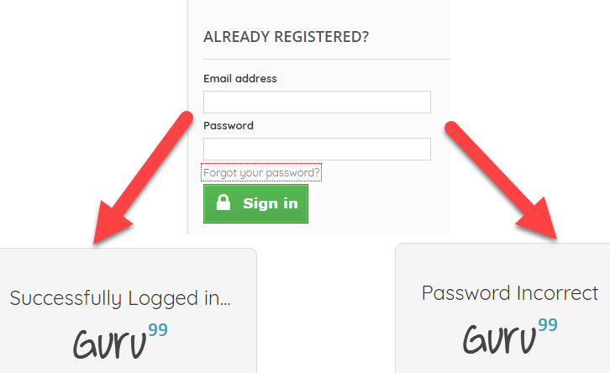
How to create a Data Driven Automation Framework
Consider you want to Test Login functionality of an application.
Step 1) Identify the Test Cases
Input Correct username and password – Login Success
Input incorrect username and correct password – Login Failure
Input correct username and incorrect password - Login Failure

Slide 17
Step 2) Create detailed Test Steps for above 3 Test Cases
TC# | Description | Test Steps | Test Data | Expected Result
1. | Check Login for valid credentials | 1. Launch the application 2. Enter Username password 3. Click Okay 4. Check Results | Username: valid password: valid | Login Success
2. | Check Login for invalid credentials | 1. Launch the application 2. Enter Username password 3. Click Okay 4. Check Results | Username: invalid password: valid | Login Failed
3. | Check Login for valid credentials | 1. Launch the application 2. Enter Username password 3. Click Okay 4. Check Results | Username: valid password: invalid | Login Failed

Slide 18
Step 3) Create Test Script
If you observe the Test Steps Remain common through the 3 Test Steps. You need to create a Test Script to execute these steps
// This is Pseudo Code
// Test Step 1: Launch Application
driver.get("URL of the Application");
// Test Step 2: Enter Username
txtbox_username.sendKeys("valid");
// Test Step 3: Enter Password
txtbox_password.sendKeys("invalid");
// Test Step 4: Check Results
If (Next Screen) print success else Fail

Slide 19
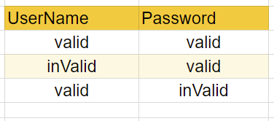
Step 4) Create an excel/csv with the Input Test Data

Slide 20
Step 5) Step Modify the Script to Loop over Input Test Data. The input commands should also be parameterized
for (i = 0; i & lt; = 3; i++) { // Loop 3 Times
// Read data from Excel and store into variables
int input_1 = ReadExcel(i, 0);
int input_2 = ReadExcel(i, 1);
// Test Step 1: Launch Application
driver.get("URL of the Application");
// Test Step 2: Enter Username
txtbox_username.sendKeys(input_1);
// Test Step 3: Enter Password
txtbox_password.sendKeys(input_2);
// Test Step 4: Check Results
If(Next Screen) print success
else Fail
}

Slide 21
Above are just 3 test cases. The test script can be used to loop over following test cases just by appending test data values to Excel
Input incorrect username and incorrect password – Login Fail
Input correct username and password blank – Login Fail
Input blank username and blank password– Login Fail
And so on

Slide 22
Best practices of Data Driven testing
It is ideal to use realistic information during the data-driven testing process
Test flow navigation should be coded inside the test script
Drive virtual APIs with meaningful data
Use Data to Drive Dynamic Assertions
Test positive as well as negative outcomes
Repurpose Data Driven Functional Tests for Security and Performance

Slide 23
Advantages of Data Driven Testing
Possibility to create Test scripts at the development stage of an application
Redundancy and unnecessary duplication of test scripts are reduced
Generates test scripts with less amount of code
All information like inputs, outputs, and the expected result is stored in the form of appropriately managed text records
Provides flexibility in application maintenance

Slide 24
Disadvantages of Data Driven Testing
Requires great expertise of scripting language
Requires large no. of data files for each test case with many inputs
For creating a new test case it requires a new driver script with different data such that the changes made to test case should reflect in the driver script or vice versa

Slide 25
Selenium Webdriver Data Driven Framework
1) Selenium Webdriver Data Driven Framework takes test input and output from ODBC sources, CSV files and Excel files.
2) The framework includes navigation through a program, reading the data files and logging test status.
3) The framework should have the following features:
Less time to test large data sets
Easier, rapid and efficient analysis
Easy debugging
Well defined architectural design
Robust, stable and reliable
Easy script maintenance
Script execution in multiple test environment

Slide 26
Creating Data Driven Tests Using TestNG
1) TestNG is a framework that makes Data Driven automation Testing possible in Selenium.
2) It is created with Junit with added features for performing regression automation testing
3) TestNG is a popular and widely used framework with Selenium Webdriver
4) It has some additional key features such as parameterization, parallel test execution etc and requires JDK 7 or higher
5) DataProviders is a data feeder method which is defined in a class that provides test methods and test data

